Slide 1
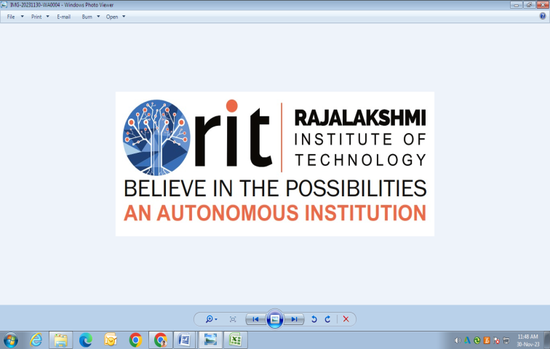
DEPARTMENT OF CSE (ARTIFICIAL INTELLIGENCE AND MACHINE LEARNING) ACADEMIC YEAR 2025 - 2026 SEMESTER III ARTIFICIAL INTELLIGENCE LABORATORY MINI PROJECT REVIEW <AI-POWERED AIR WRITING RECOGNITION SYSTEM >
REGISTER NUMBER | 2117240030145
NAME | SRI HARISH A
YEAR | II
SECTION | C
FACULTY IN-CHARGE | MRS M BHAVANI

Slide 2
PROBLEM STATEMENT
To develop a real-time system that detects hand motion using a webcam and recognizes characters written in the air.
The system should accurately track the fingertip, visualize the writing path, and predict the letter drawn using a trained deep learning model

Slide 3
THEORETICAL BACKGROUND
Air writing recognition combines computer vision and machine learning.
Computer Vision: Uses OpenCV and MediaPipe to detect and track hand landmarks, especially the index fingertip.
Machine Learning (CNN): The CNN model learns to classify the letter drawn by analyzing pixel patterns from the captured air-written images.
MediaPipe provides accurate hand tracking by identifying 21 key landmarks on the hand. OpenCV helps visualize and record the movement path. The recorded images are used to train a CNN classifier that predicts which alphabet letter has been drawn.
This integration demonstrates an application of gesture recognition and pattern classification, which are core components of Artificial Intelligence systems.

Slide 4
IMPLEMENTATION AND CODE
Link to code in Git-hub Repository
List | Git-hub Repository Links
Implementation of Code Link | https://github.com/sriharisha2006-hash/AI-MINI-PROJECT-2117240030145.git
Word Document Report Link | SRI_HARISH_AI_MINI[1].docx
PPT Link | SRI HARISH A MINI PPT.pptx

Slide 5
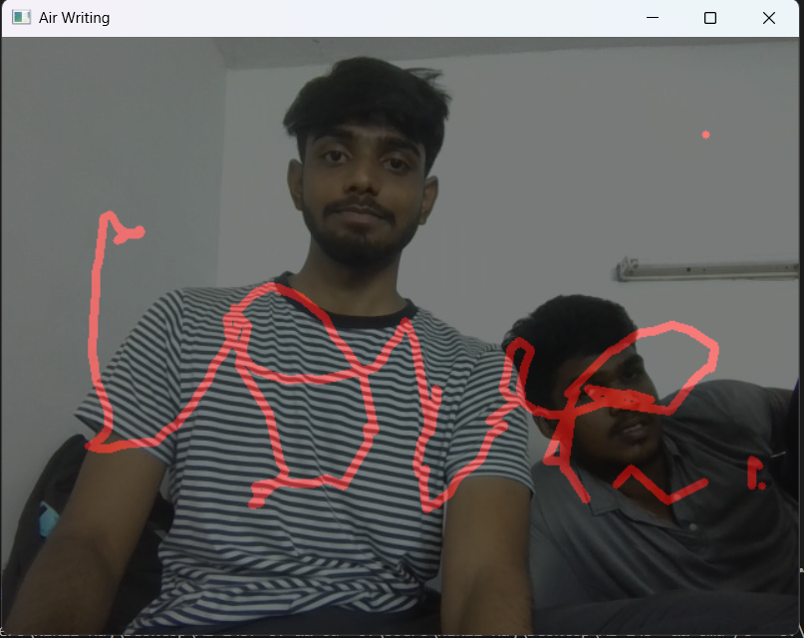
OUTPUT AND RESULTS
Output Screen shots

Slide 6
OUTPUT AND RESULTS
The Air Writing Recognition System successfully tracks hand movement and recognizes letters drawn in the air. The system uses MediaPipe for accurate hand detection and a CNN model for prediction.
Future Enhancements:
Recognizing words instead of single letters.
Improving accuracy using Recurrent Neural Networks (RNNs).
Adding gesture-based control for switching modes or clearing the screen.
Developing a mobile or AR-based version for enhanced interactivity.

Slide 7
REFERENCES
MediaPipe Documentation (2024) – Google Developers.
OpenCV-Python Tutorials (2024).
TensorFlow Documentation (2024) – Image Classification Guide.
GeeksforGeeks (2025) – Hand Tracking using MediaPipe.
Chat gpt Ai resources

